Slide 1
Extending SharePoint 2010 Search
Notes:
Microsoft invested considerably in search in SharePoint 2010 from the previous release. This module will explore the different capabilities of search in the SharePoint 2010 stack including SharePoint search and FAST Search. In addition you will learn how to customize and extend the search experience.

Slide 2
Agenda
Search Enhancements for End Users & IT Pros
Social Search
Scaling Search Services
Federated Search

Slide 3

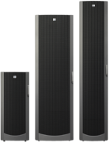

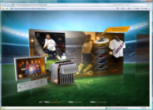



Enterprise Search Matters
Create experiences that combines software with the power of Internet services across all devices
Search is the key to engaging information experiences
DESKTOP
ENTERPRISE
ONLINE
DEVICES
Notes:
Searching mechanisms across all platforms are necessary to really engage the users and provide timely information.
Desktop search is available through Windows Vista and 7.
Enterprise searchdrives information worker productivity. Software should be intuitive and information more accessible.
Online – Bing provides a decision engine to search for information.
Devices such as smart phones, iPhone, XBOXes and more are used by users all the time to execute non-workstation based searches.

Slide 4



SharePoint 2010 Search Products
Quick, easy, powerful search (for free!)
Complete intranet search
High-end search delivered through SharePoint
Visual experiences, extreme adaptability and advanced content processing
Powerful platform to build on
360° customer views
Research portals
Reputation analysis
Basic search
Intranet-wide search
People and expertise search
Notes:
Search Server Express - Free SKU anddownloadable. Basic search offering, business data connectivity, standard federation web parts and features. Consolidated Admin UI. Easy to setup and deploy!
SharePoint Server - Core scenarios include Intranet and People and expertise search. Open and extensible platform.
FAST Search – superset of SharePoint Server Search providing a richer visual experience to the user. Relevance customization and overall user experience customizations to tune to meet your business needs. Advanced content processing to enable metadata extraction from content. Most powerful platform to build applications on top of. High end search delivered through SharePoint. You can start using SharePoint Server search and then later move to FAST or start with FAST directly.
The focus of this presentation will be SharePoint Server search.

Slide 5
Search Highlights in SharePoint 2010
Scale: content and query scale becomes a non-issue
User experience: guide users with rich, visual navigation
Social and people search: search unlocks the value of the people and expertise
Relevance: improving our matching and ranking capabilities and language support
Platform: tools to customize, extend, or build new applications.
Management & reliability: reliable crawling, scriptable admin, improved monitoring.
Rich Content Processing: extract metadata from my enterprise content

Slide 6
Search Technology Concepts
Search Center: UI for users to issue queries and interact with results
Query Servers: Accept query requests from users and return results
Query Federation: Return results from non-SharePoint Indexes
Indexing: Extract information from items to enable efficient matching
Index Partition: Subset of the overall index
Crawling: Traverse URL space to record items in search catalog
Connectors: Know how to process different content sources
Content Sources: Host the content we want to return in main results
Notes:
Content sources: Content you want to index and make searchable through Admin UI
Crawling: Following hierarchies, traversing through the data
Connector: knows how to interface between crawler and repository being crawled– exchange, sharepoint etc
Index: flat file and property store created
Index partition: subset of the full index
Query servers: index is propagated to query servers. Answers the end users for queries. Federation is a open source search which has its own index
Search center: where user executes the queries and interacts with the search services
In SharePoint 2010, you can have multiple servers for any one of these roles. Scale is a non issue.

Slide 7
SharePoint Search Architecture
.
.
.
SharePoint Sites
SSA Database
Metadata Database
Crawl Database
Index Repositories
Get metadata info from SQL
Remote File Shares
Send Query
Send Query to full text index
WFEs
Query Processor
Query servers
Index Servers
Custom Repositories
Get Results
Propagate index + metadata to query server & DB
Get Results from full text index
Web Sites
.
.
.
Notes:
Index servers reads config information from the crawl DB
Index server crawls the content and it goes through the indexing pipeline
Send index + metadata to Query sever + metadata database
WFE sends query to QP
QP sends to QS + MD
QP gets results back and sends to WFE

Slide 8



Enterprise Search for All Levels
End User
IT Professional
Developer
Go beyond the search box
Eliminate compromise
Do more with search
Notes:
End Users can find, connect and explore with the information and people in the org.
IT Professionals – eliminated compromise between manageability and capability making a much easier to satisfy diverse searching needs throughout organization as well as having a platform for future growth.
Developer – provided familiar tools to create custom search solutions and search driven applications.

Slide 9
End-User UI
Out-of-box refinement
Refine over key results properties
Metadata, taxonomy and social tags based results refinement
Easy to extend over custom properties
One-stop Search Center
Scopes, Web Parts, best bets, top answers, advanced search
Query federation brings together results from all over - native support for OpenSearch
Core search experience
Improved did you mean suggestions
New pre-query and post related query suggestions
“View in browser” link (for most office docs)
Improved query syntax
Notes:
Key properties such as modified date, author are available to narrow down your results (refinement).
Refinement – Easily extended through xml configuration to show more refinement.
Search Center:One stop place for all searches. Your keywords, best bets and all appear here. Query federation is available to bring information from various locations.
Improved ‘did you mean’ suggestions. Natural Language (NLG) components. Pre and post query related suggestions. When typing in a query, it suggests various query terms to search with.
View in browser link available for most Office documents so you can view the documents directly in the browser (as long as the Office Web Apps services is running on the server).

Slide 10
End-User UI
Improved relevance ranking
New ingredients: URL fuzzy matching, social tags, results click through, implicit phrase matching, extracted metadata, etc.
Improved low-noise snippets in summaries
Enhanced multi-lingual support
Automatic detection of language of many document types and part of documents
Compound word handling - e.g., Innovationszyklen” and ”innovation“, “zyklen”
Improved ranking of documents in multilingual collections
New form factors
Mobile search from Smartphone browsers
Desktop search integration in Windows 7
Notes:
Multi Language auto detect incorporated in SharePoint search (comes from FAST search product). Very accurate in detecting the languages when items are crawled.
URL fuzzy matching, for example: http: //www.yahoo.com/groups/*/member/*.htm, * Filters for Link URL or Link Text.

Slide 11
New Query Syntax
Support for Boolean operators for FreeText queries and property queries
(“SharePoint Search” OR “Bing Search”) AND (title:“keyword syntax” OR title:”query syntax”)
Prefix matching support for keywords and properties
Micro* author:bill*
Improved operator support for property restrictions
=, >, <, <=, >=
Can create range refinements
Notes:
Date refinements can be done using range refinements.

Slide 12
DEMO
End User Experience

Slide 13
Agenda
Search Enhancements for End Users & IT Pros
Social Search
Scaling Search Services
Federated Search

Slide 14
Search is Social
People finding experience
Front door to the office social network
Better expertise & interest search
Email mining to bootstrap profiles with interests and colleagues
“Address book style” search
Phonetic name matching
Nickname matching
Relevance models tuned specifically for people search
Metadata refinement, better hit highlighting, recently authored content
Notes:
Mines your interests from Exchange. You can then decide what you want to keep and what not to keep.

Slide 15
Search is Social
Social behavior drives search quality
Search click through behavior drives relevance ranking
Query suggestions mined from search logs
Social tagging influences relevance ranking
Self search - to drive people to participate content
Social definitions extracted from indexed content
Notes:
Use click thru behavior for search results. If people are clicking a search result, its relevance goes up.
Pre-query suggestions from search logs directly. Logs contain previous searches that people have done.
Self Search - How many search result has brought you up in the past.
People tagging results tell you to trust that more than other searches. Ex: If you search for “asp”, it will tell you what people are saying about “asp”.

Slide 16
DEMO
People Search

Slide 17
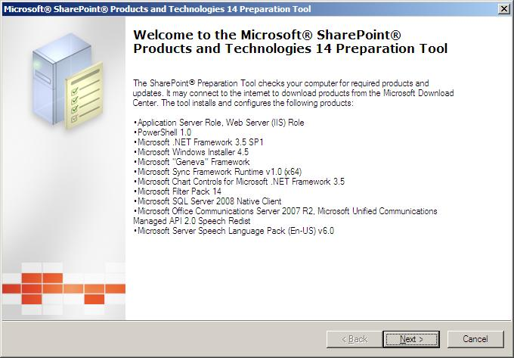
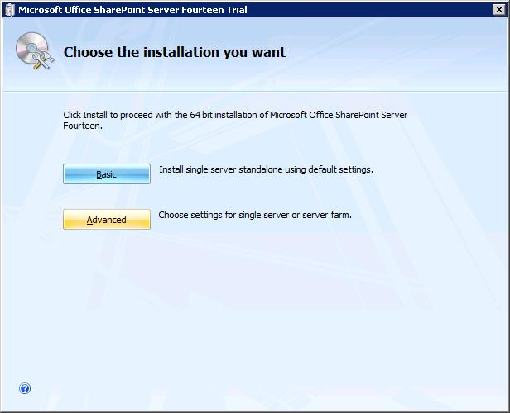
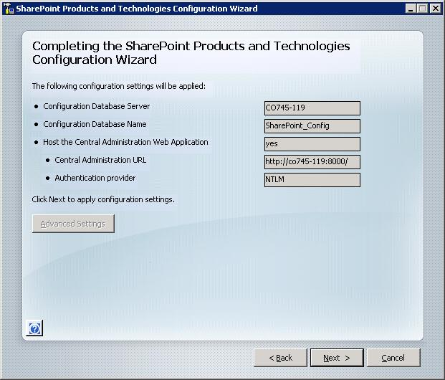
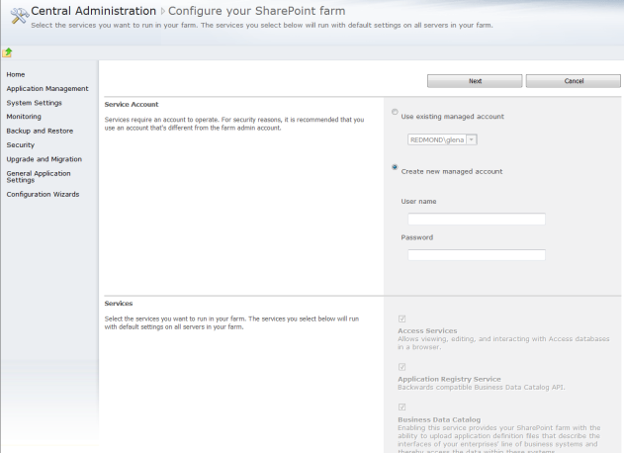
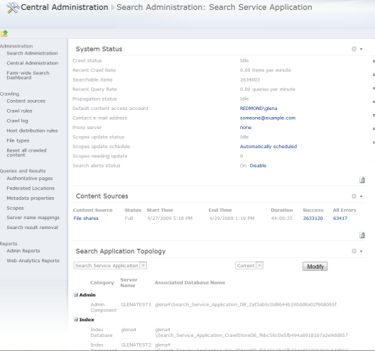
Deployment Simplicity
SharePoint Server Setup
SharePoint Server post setup config
Farm Config Wizard
Search Dashboard
Prerequisite Tool
Notes:
Search is deployed with SharePoint server. No additional things to tweak. Just follow the wizard for SharePoint installation and you are done! Of course, you can (and should) configure the SharePoint search as needed afterwards to your needs.

Slide 18
Search Engine Enhancements
Support for regular expressions in crawl rules
Native support for crawling case sensitive repositories
Ability to prioritize content sources so as to distribute crawler resources
New crawl policy to define how crawler treats error conditions
Low indexing downtime search backups
Notes:
Crawl policy is per content source. Ex: What to do with data that does not return back as available (ex: server down that has data). You can write a crawl policy for this.

Slide 19
Agenda
Search Enhancements for End Users & IT Pros
Social Search
Scaling Search Services
Federated Search

Slide 20















Easily Connect to Corporate Assets that Live Outside of SharePoint
Files
OpenSearch Federation
Web
Databases
SharePoint
Easy to Connect
Easy to Build
Exchange Server
Enterprise Content Mgmt Systems
Custom Apps
Asset Mgmt systems
Line of Business Apps
Documentum
Indexing Connectors
Lotus Notes
…
Notes:
Common connector framework to connect to data repositories and easy to build additional connectors.
Query Federation:
Open search federation lets you bring in content from outside sources like LinkedIn, Bing and Wikipedia.
Based on Open Search standard.
Exposed through UI + public federation object model.

Slide 21
Search Services Manageability
Consolidated administration UI dashboard
Automated service password management through “managed accounts”
Windows PowerShell support for scripted administration
Built-in and extensible search analytics reporting
Notes:
The Search administration dashboard provides a rich experience to configure and extend the out of the box search experience. All of the commands available through the Search dashboard can also be scripted using Windows PowerShell.

Slide 22
DEMO
Search Administration & Configuration

Slide 23
Summary
Search Enhancements for End Users & IT Pros
Social Search
Scaling Search Services
Federated Search

